Slide 1
Invest in your family with a
Flexible Spending Account

Slide 2
Your Flexible Spending Accounts (FSA)
Making it easier to manage dependent care costs while you work.
Expense accounts that help you pay qualified medical and dependent care expenses tax-free
Set aside a portion of pre-tax payroll
Save 10 to 40% on these costs, depending on tax bracket
¹ Depends on your income tax bracket. Consult a tax advisor for more information.

Slide 3
How your FSAs Work
Estimate next year’s eligible medical and dependent care costs
Employer opens an FSA for you
Equal portions deposited from your paycheck:
Money for medical FSA is available day one
Money for dependent care is available when deposited
Estimate only what you think you will use¹
A spouse in another plan may also open an FSA:
Medical FSA – each can be up to $2,600²
Dependent Care FSA – combined limit is $5,000
Submit claims for reimbursement – online or by faxing
Depending on how your employer sets up the account, money may be forfeited at the end of the plan year or grace period
Total amount contributed for each account cannot exceed $2600

Slide 4
Meet the Garcia’s
Two parent family of 4
Maria’s annual salary | $46,000
Carlos’ annual salary | $42,000
Taxable income | $88,000
Medical FSA contribution | $1,200
Dependent care FSA contribution | $5,000
Taxable income with FSAs | $81,800
Estimated tax rate | 25%

Slide 5
The Garcia’s savings
 | Without an FSA | With an FSA
Medical FSA contribution | $0 | $1,200
Dependent care FSA contribution | $0 | $5,000
The Garcia’s estimated taxes¹ | $22.000 | $20,450
Health care expenses | $1,200 | $1,200
Dependent care expenses | $5,000 | $5,000
Health care FSA | $0 | $1,200
Dependent care FSA | $5,000 | $5,000
The Garcia’s tax savings | $0 | $1,550
Net disposable income | $59,800 | $61,350
¹ Assumes Maria and her husband file jointly and pay 25% of their income in federal, State and social security taxes. Your actual tax savings will depend on your FSA contributions, State tax rates and your personal tax situation. Please consult a tax adviser for details.
The Garcia’s story is a hypothetical example for purposes of illustration only.

Slide 6
Qualified medical expenses
Expenses you can pay for:
These you can’t pay for:
Qualified medical treatment or care
Costs not covered by health plan:
Out-of-pocket
Co-pays and co-insurance
Prescription drugs
Certain health expenses not included in your health plan:
Dental and vision care
Expenses not related to medical treatment or care
Over-the-counter medicine
Non-prescription drugs
Supplements
Health insurance premiums
Always save your receipts to ensure proper validation of expenses, as required by the IRS.

Slide 7
Qualified dependent care expenses
To allow you to work, these expenses you can pay for:
These you can’t pay for:
Licensed day care facilities
Licensed pre-school and after-school programs
In-home care services
Elder care
Special day camp expenses
Kindergarten or school tuition
School lunches and food items
School activity fees
Overnight camp
Always save your receipts to ensure proper validation of expenses, as required by the IRS.

Slide 8
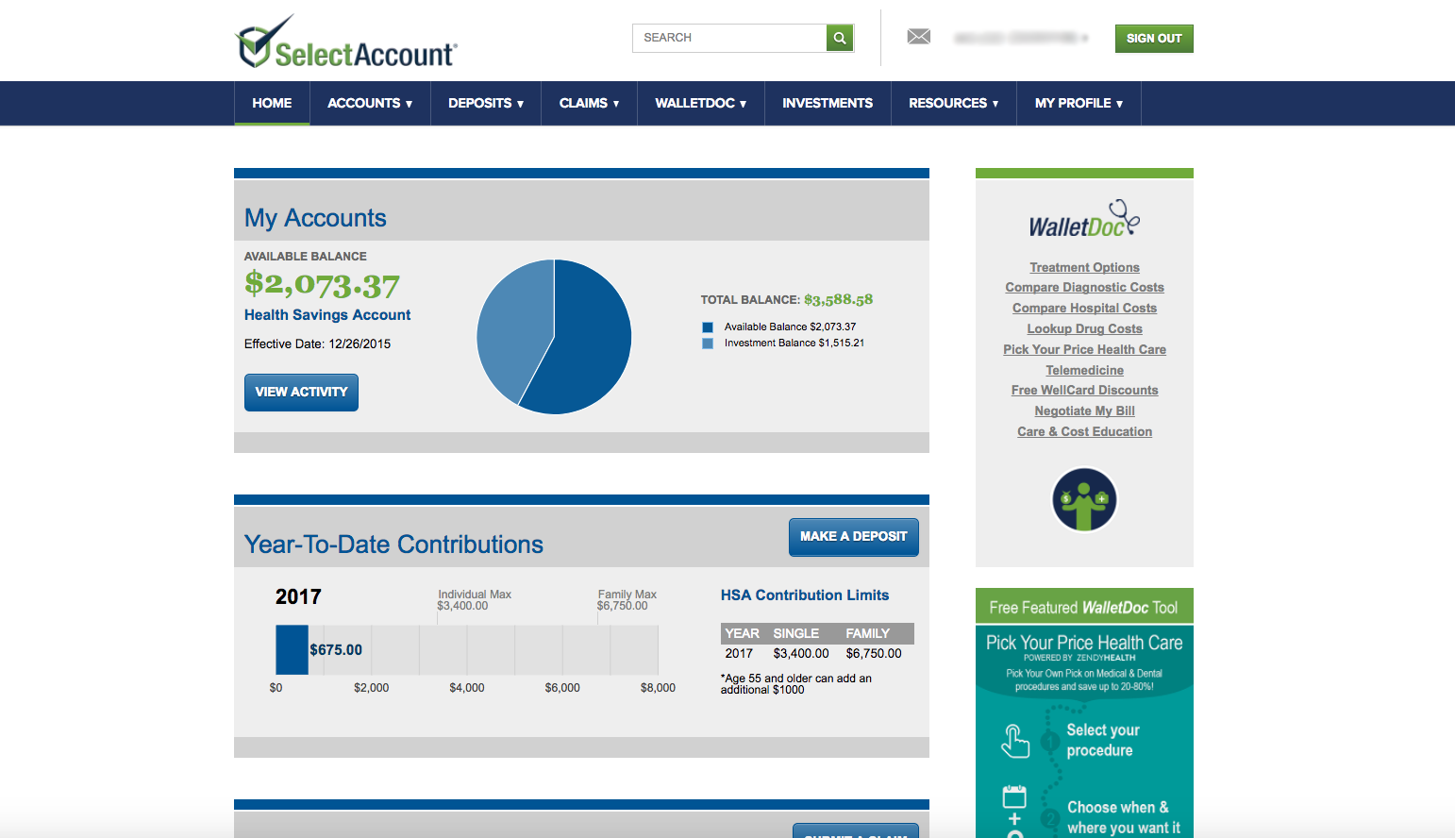
After you’re enrolled
Receive your SelectAccount I.D. by mail
Register at SelectAccount.com
Receive your debit card by mail
Get the mobile app
Pay dependent care providers and submit claims for reimbursement
Pay medical providers with debit card

Slide 9
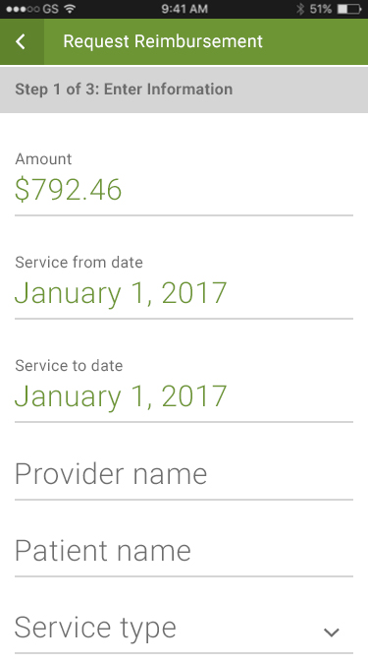
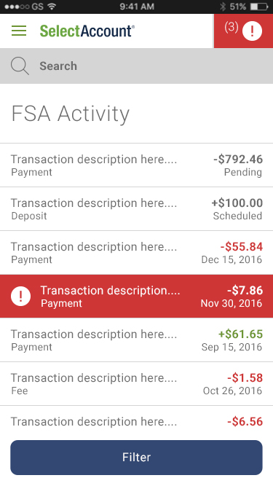
Manage your FSA at SelectAccount.com
View account activity and check balances
Download forms and upload receipts
Request additional debit cards

Slide 10
800-859-2144
Monday thru Friday 7 a.m. to 8 p.m. CST
Let’s get started
Our expert service team is ready to help.
SelectAccount.com

Slide 11
Thank You!

